Slide 1
Black History Brain Bowl 2018
And the Trophy Goes to…….

Slide 2
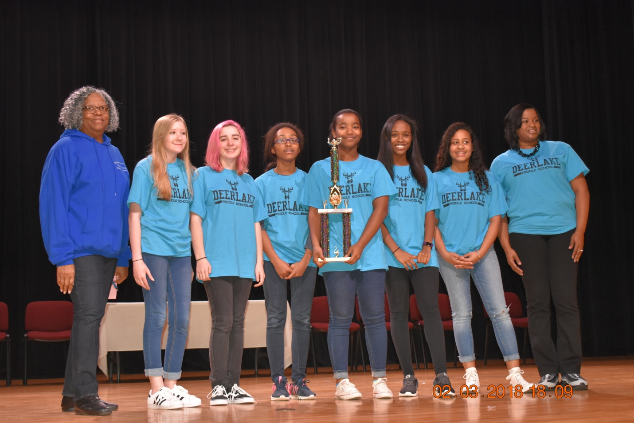

Slide 3
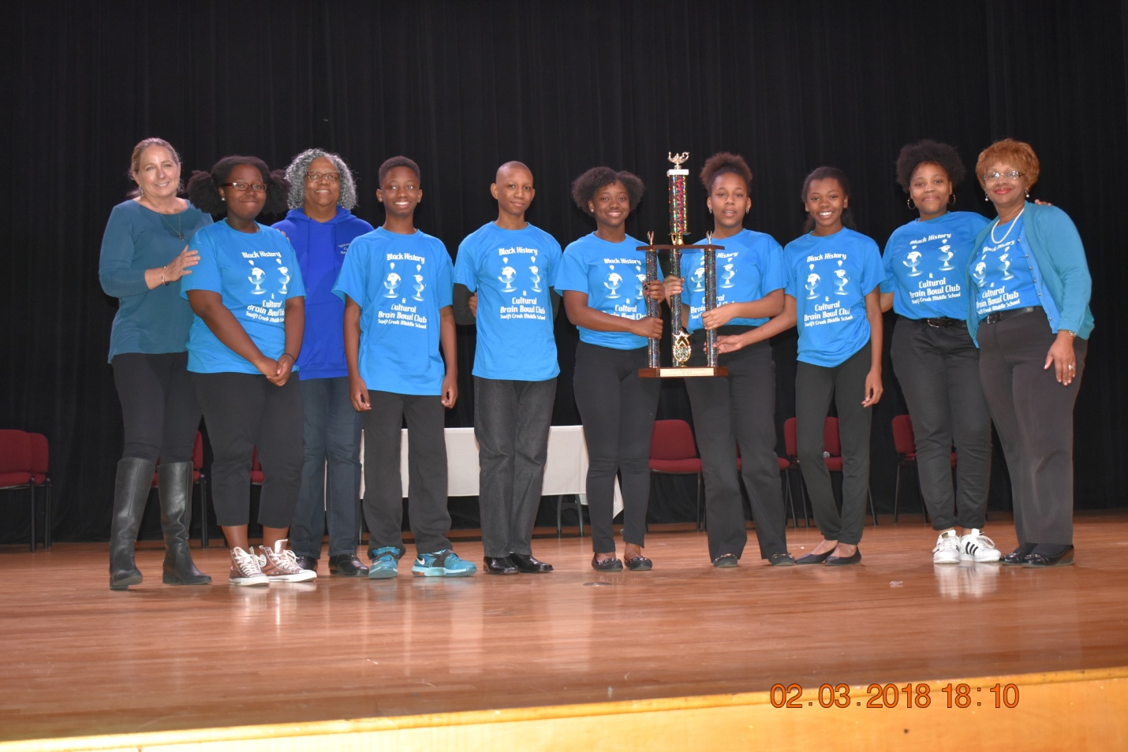

Slide 5
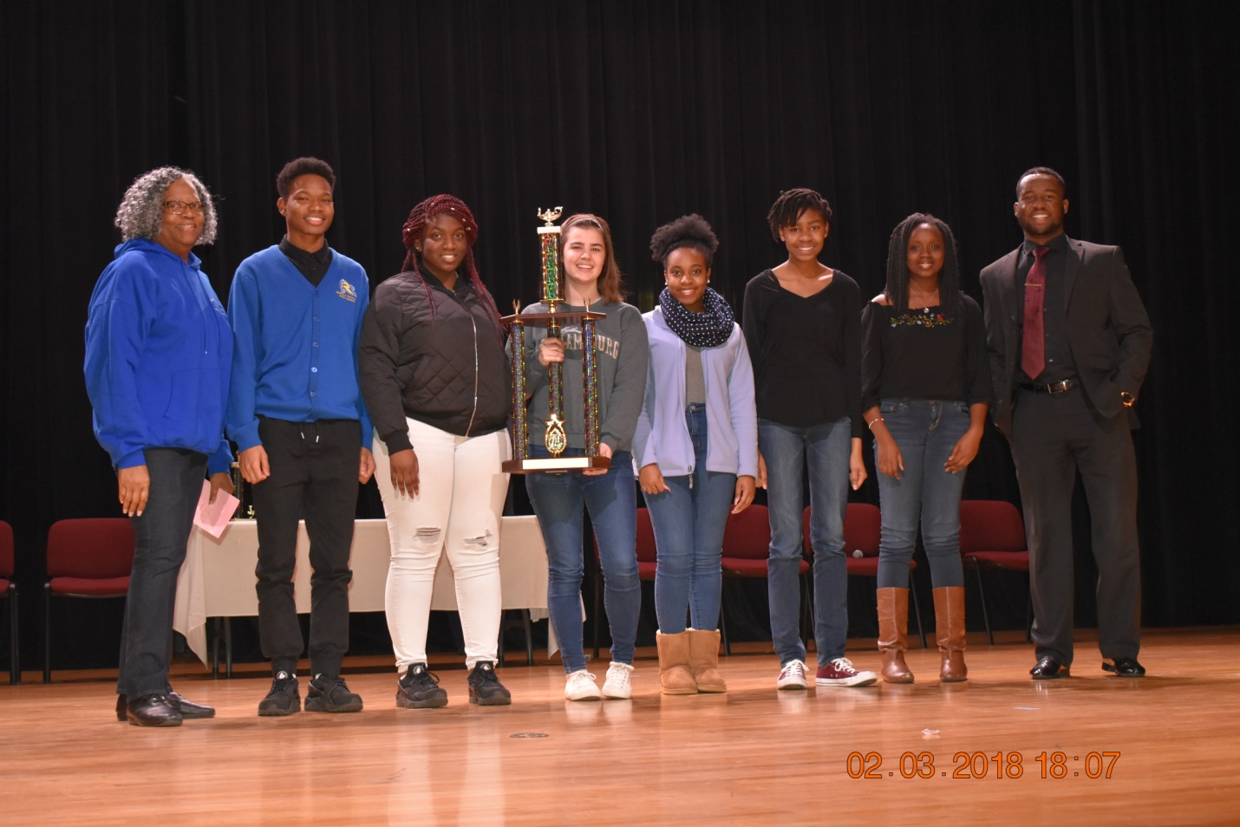

Slide 6
